Slide 1
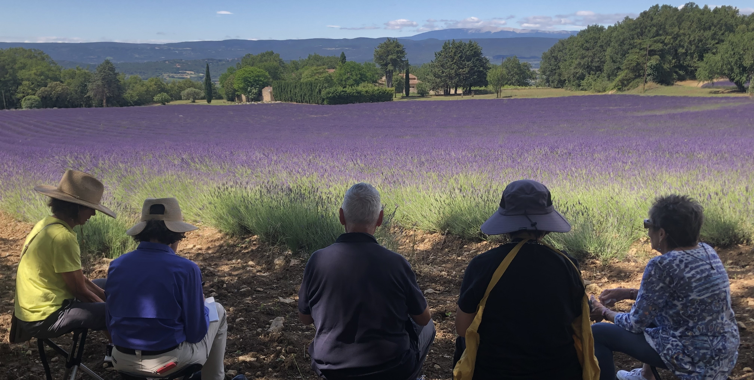
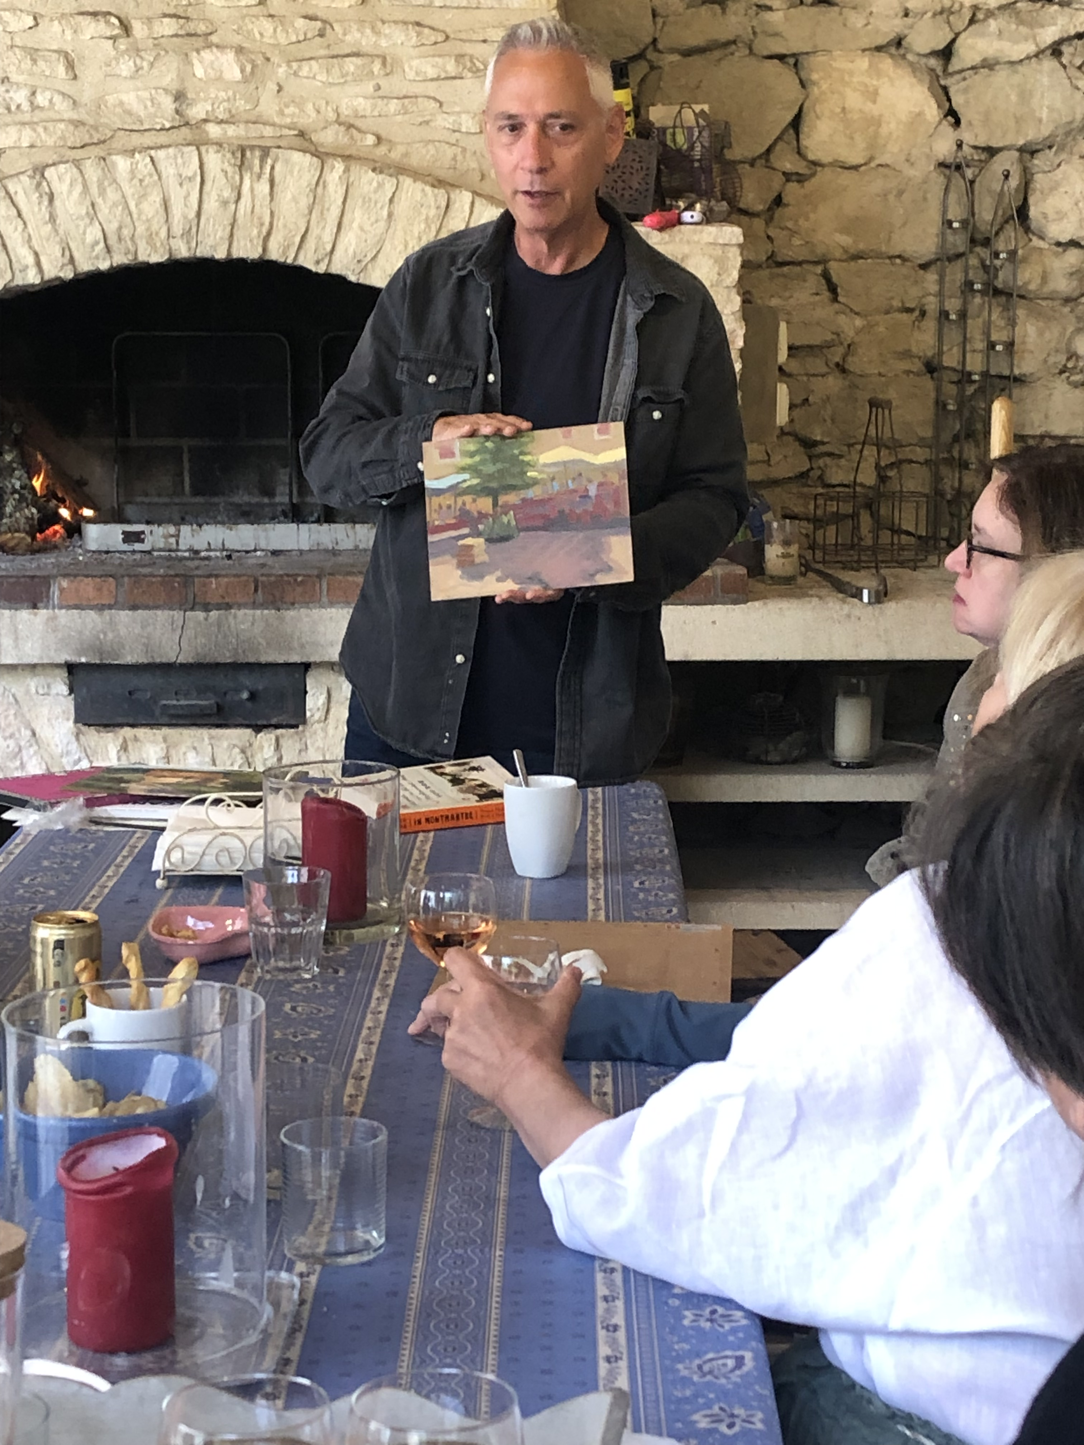
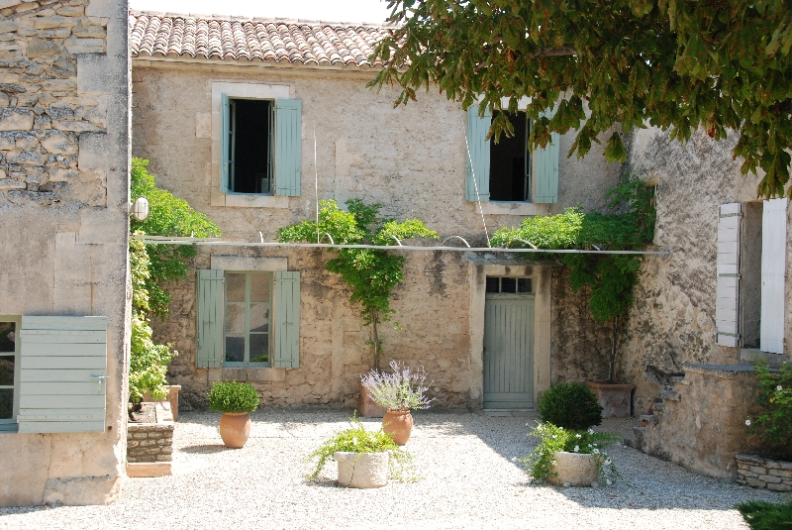
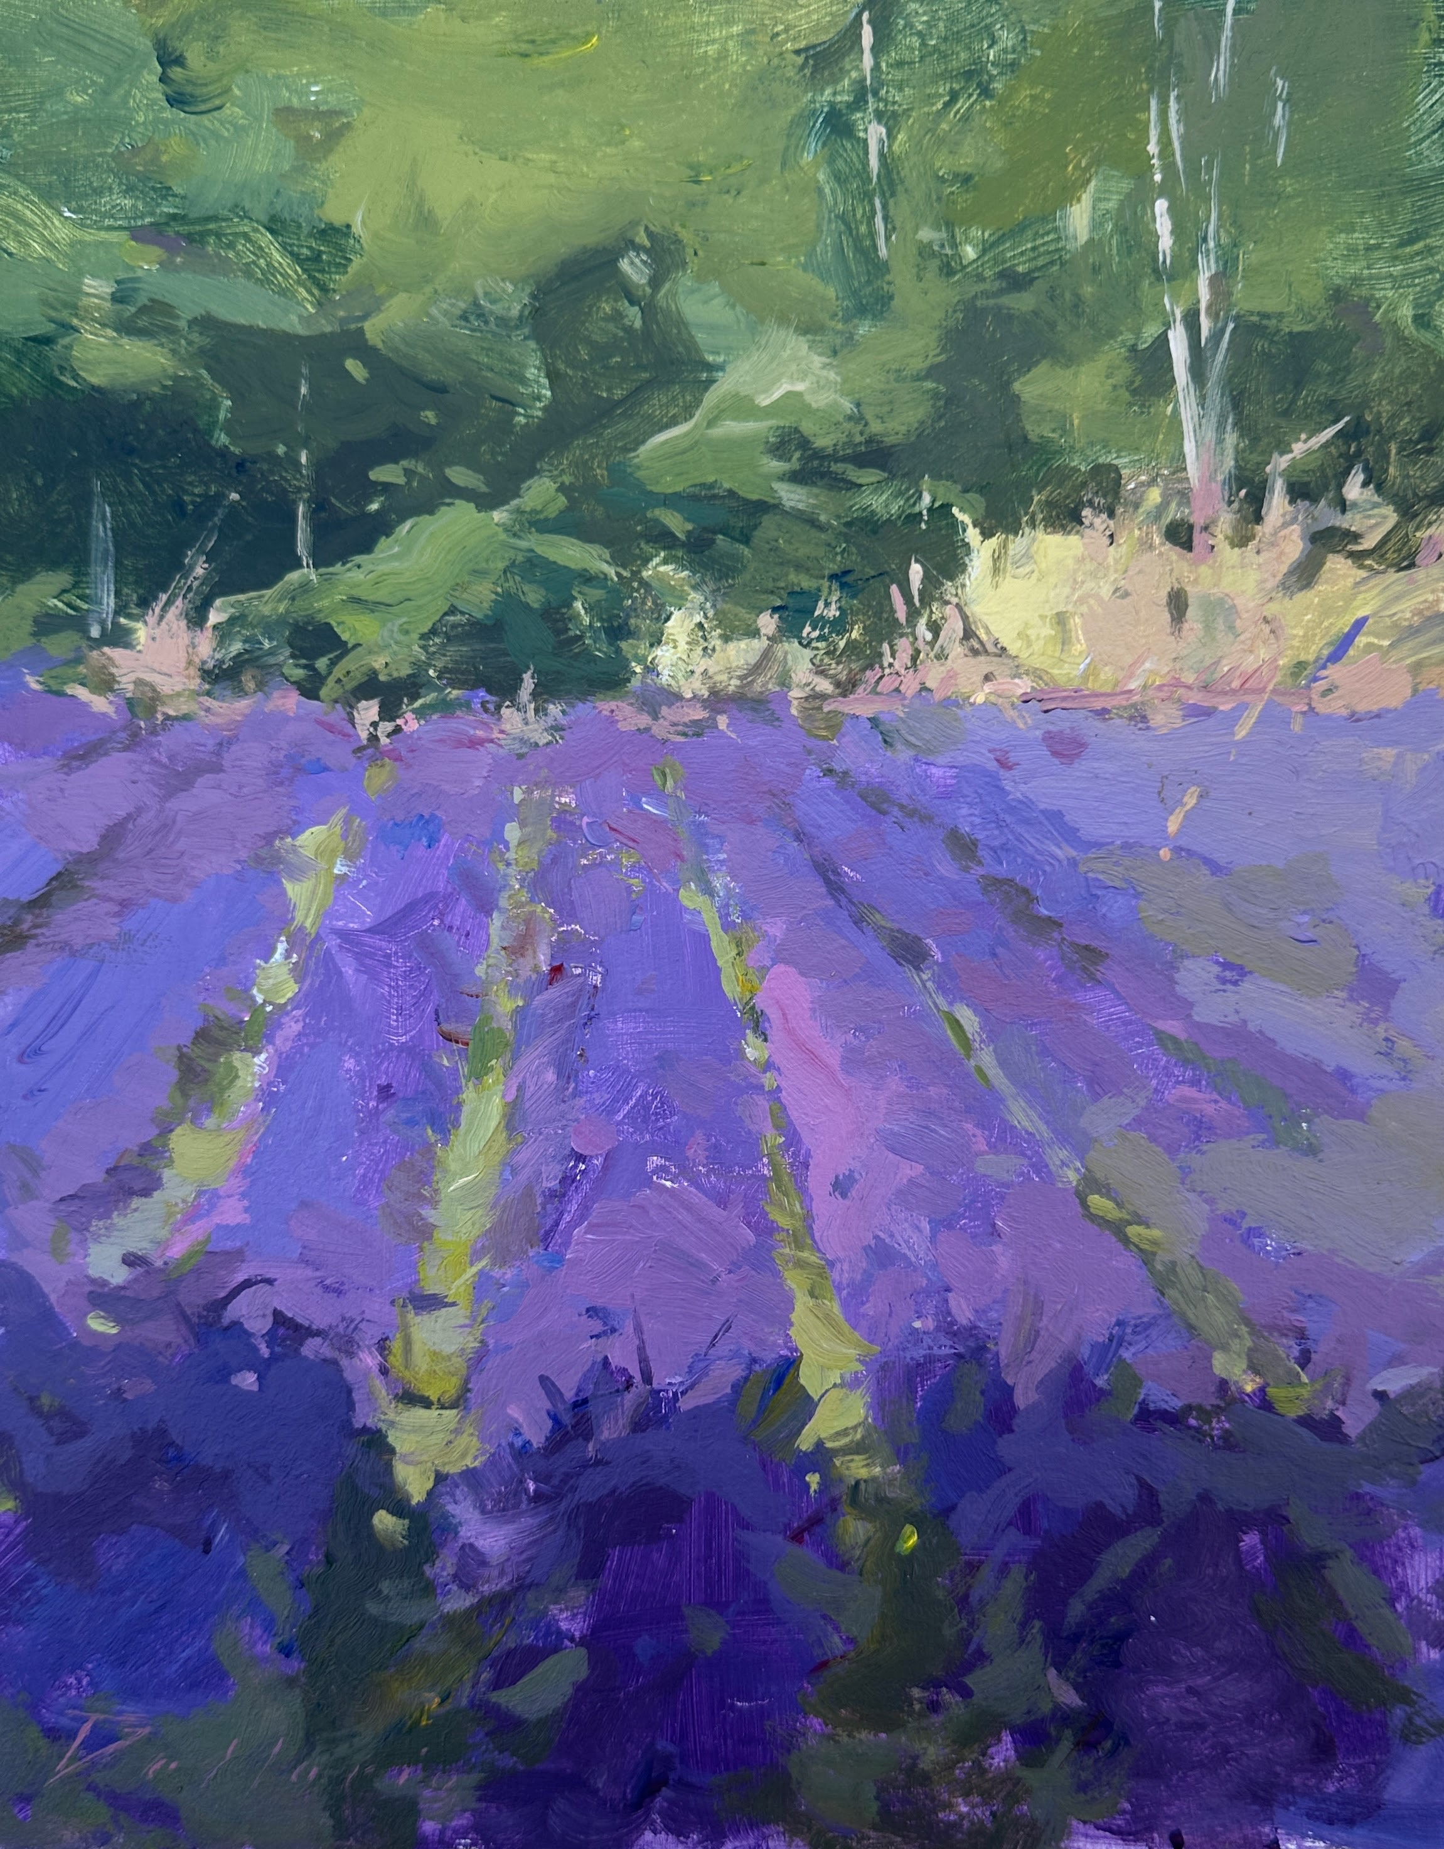
Painting in Provence, France Workshop
Bernie Dellario Instructor June 18-25, 2026
You are invited to join well-known artist Bernie Dellario on this instructional workshop taking place during the peak lavender season. This will be an extraordinary small-group experience staying in a centuries-old villa in the heart of the picturesque Luberon.
This popular instructor has daily lessons and demos planned, and the small number of students(10 max.) means plenty of quality time and instruction with Bernie. You will be able to paint right from the property. Offsite excursions include Pont Julien, the ancient Roman Bridge, the picturesque stone villages of Lacoste and Bonnieux, and Menerbes and the oldest market in Provence, Apt.
Focus on your art in an immersive and inspiring environment with like-minded friends and instruction that will move you forward in your artistic journey.
We offer a breakfast buffet daily that includes local seasonal fruit and other staples in addition to fresh croissant and bread from the bakery every morning . One additional meal each day (either lunch or dinner prepared at home) is also included with nutritious, delicious food, and wine, or beverage of choice.
The cost for the workshop is $3500 per person.. This fee includes lodging (based on double occupancy) transfers to and from either the Marseille airport or Avignon train station. 2 meals per day, (breakfast daily plus lunch or dinner), and instruction daily with Bernard Dellario. Space is limited, so sign up soon! Please contact josievosoba@gmail.com to reserve your spot. More details can be found on the website:
www.lavenderandvine.net

